Slide 1
ESFP-II
SHAH JEET
SUTAIL DHRUV
VAGDODA MANAV

Slide 2
COMPUTER NETWORK MANAGEMENT SYSTEM.
CONCEPT:
This project is based on the concept to utilize the current entered data by the different users.
Using this concept we can sort the data accordingly and can have a systematic,organized and well-managed ecosystems.

Slide 3
COMPUTER NETWORK MANAGEMENT SYSTEM.
CONCEPT:
We can also perform certain operations according to the data entered and can use that redefined data to take more use of it.
We can solve problems at a much bigger scale without too much of extra efforts and human forces.

Slide 4
COMPUTER NETWORK MANAGEMENT SYSTEM.
ALGORITHM TO BE USED:
We are going to use classes(with inheritance),objects,and some functions to create the basic back-bone of the system.
Then we will be using the ROW-MATRIX methods to store and display the inputted data and according to the users requirement the particular data will be fetched if the condition is met.

Slide 5
COMPUTER NETWORK MANAGEMENT SYSTEM.
ALGORITHM TO BE USED:
That can be done using string comparison and when the entered value and the default value are same or the string comparison results to 0.
The system can take it as the correct value and the particular data related to that data input along with the other details is printed as an output.

Slide 6
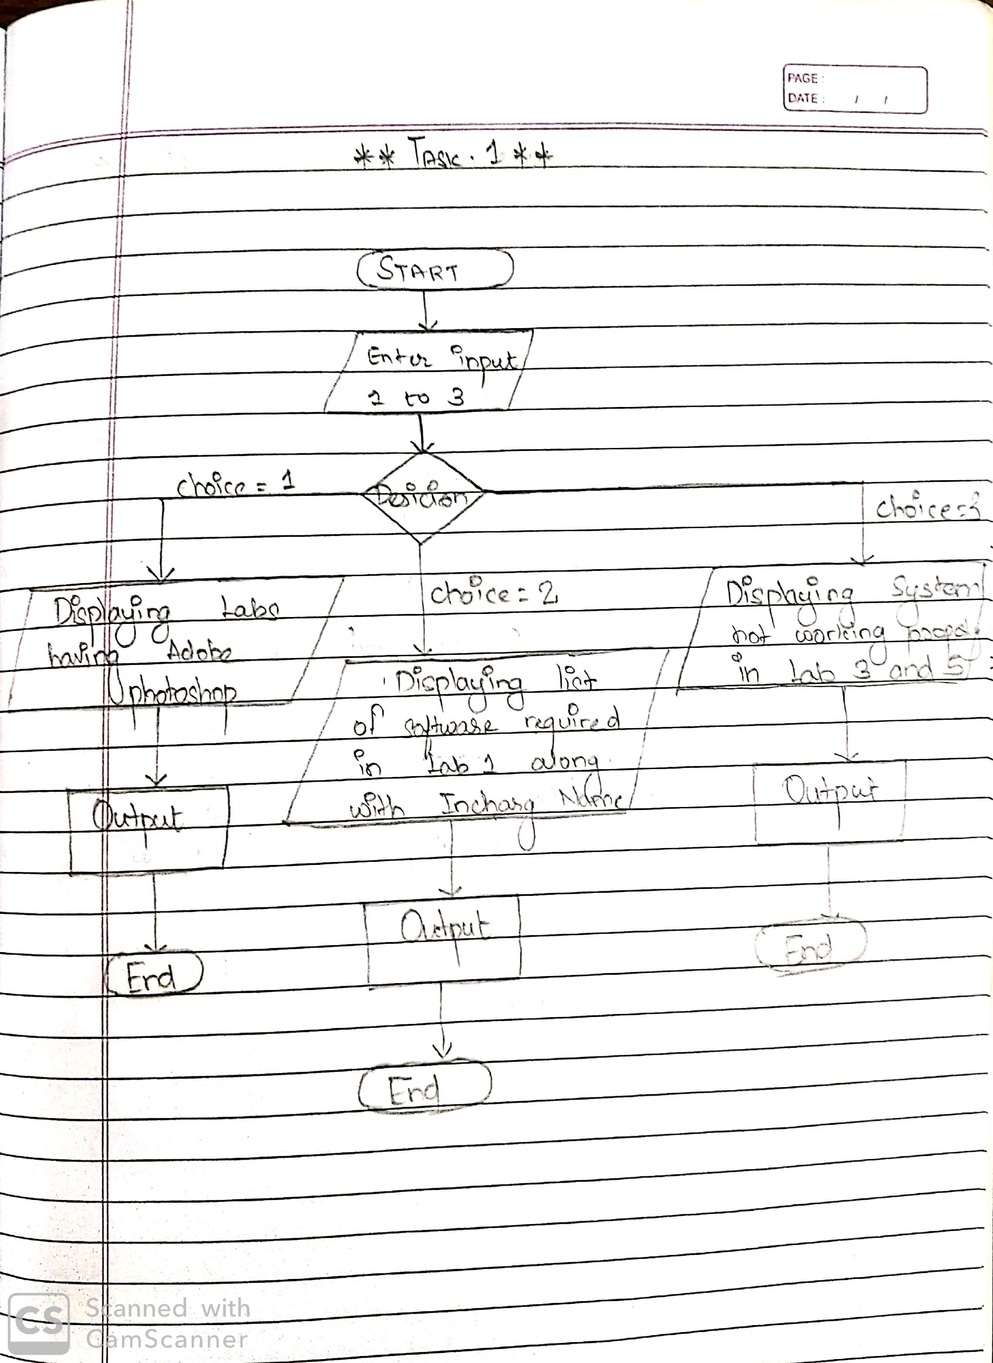
FLOWCHART:-

Slide 7
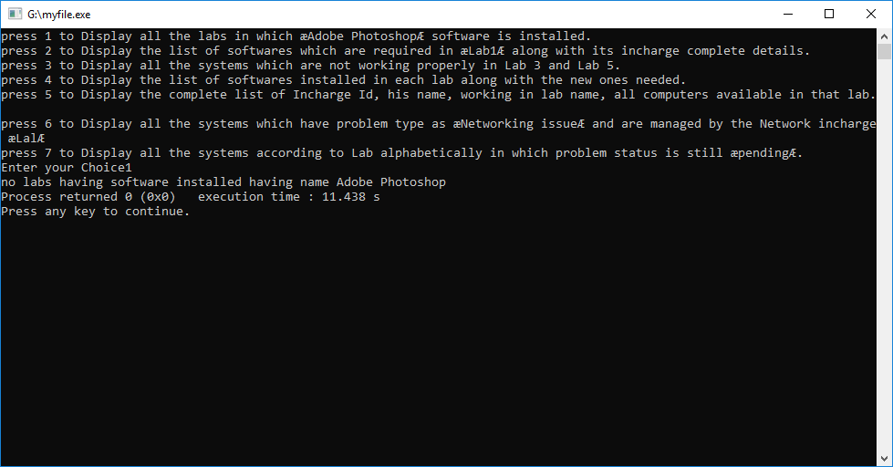
MEMBER-1 Task-1: Display all the labs in which ‘Adobe Photoshop’ software is installed
=>Screenshot

Slide 8
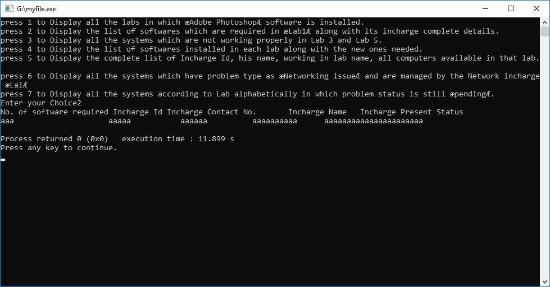
Task-2: Display the list of softwares which are required in ‘Lab1’ along with its incharge complete details
=>Screenshot

Slide 9
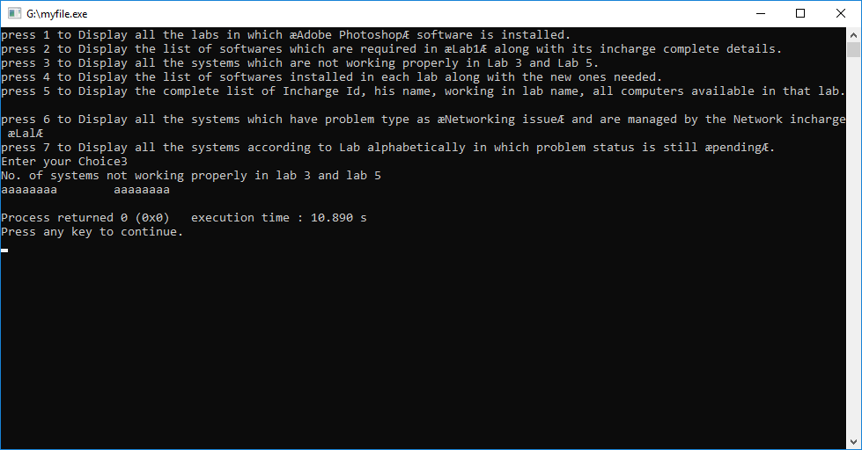
Task-3: Display all the systems which are not working properly in Lab 3 and Lab 5
=>Screenshot

Slide 10
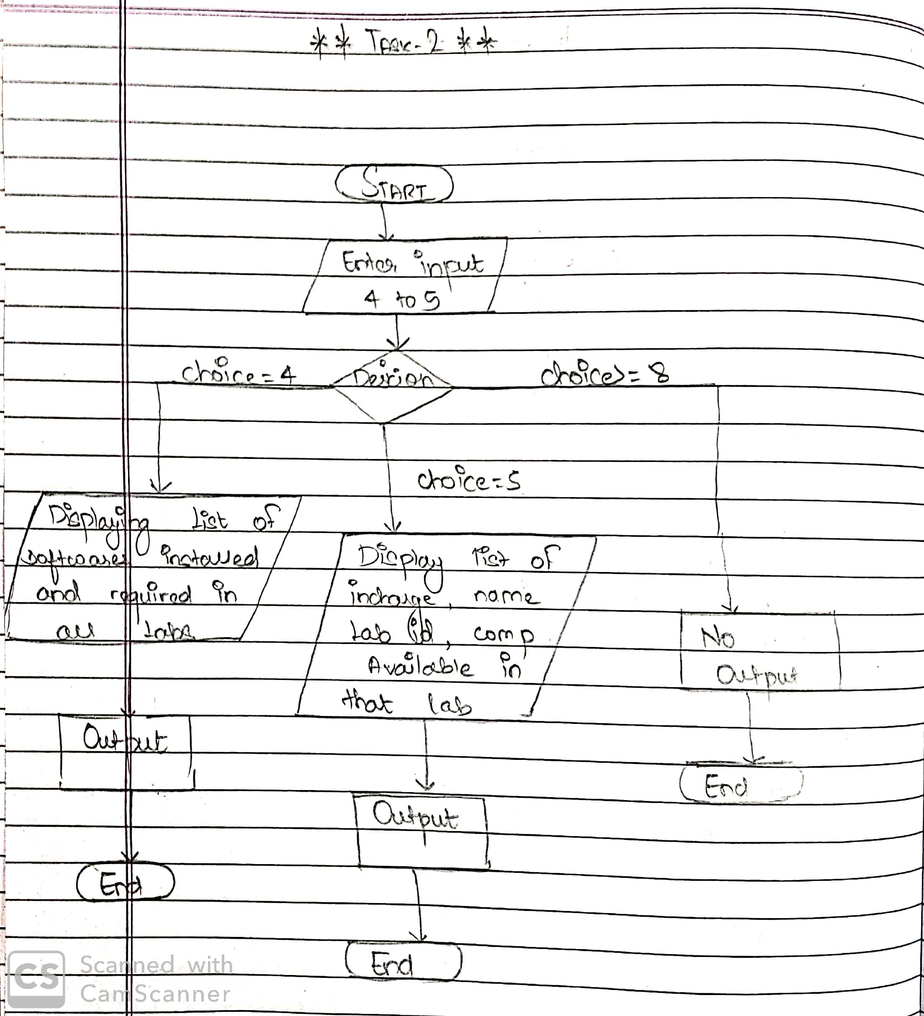
FLOWCHART:-

Slide 11
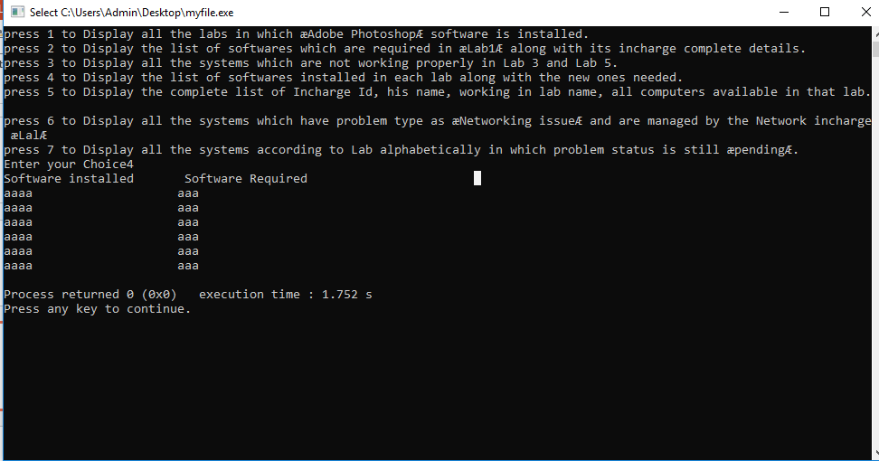
MEMBER-2 Task-4: Display the list of softwares installed in each lab along with the new ones needed.
=> Showing the Screeenshot of static value:

Slide 12
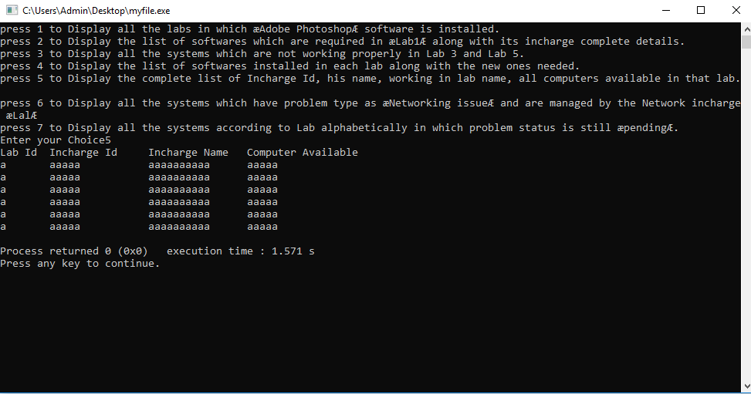
Task-5: Display the complete list of Incharge Id, his name, working in lab name, all computers available in that lab
=> Showing the Screeenshot of static value:

Slide 13
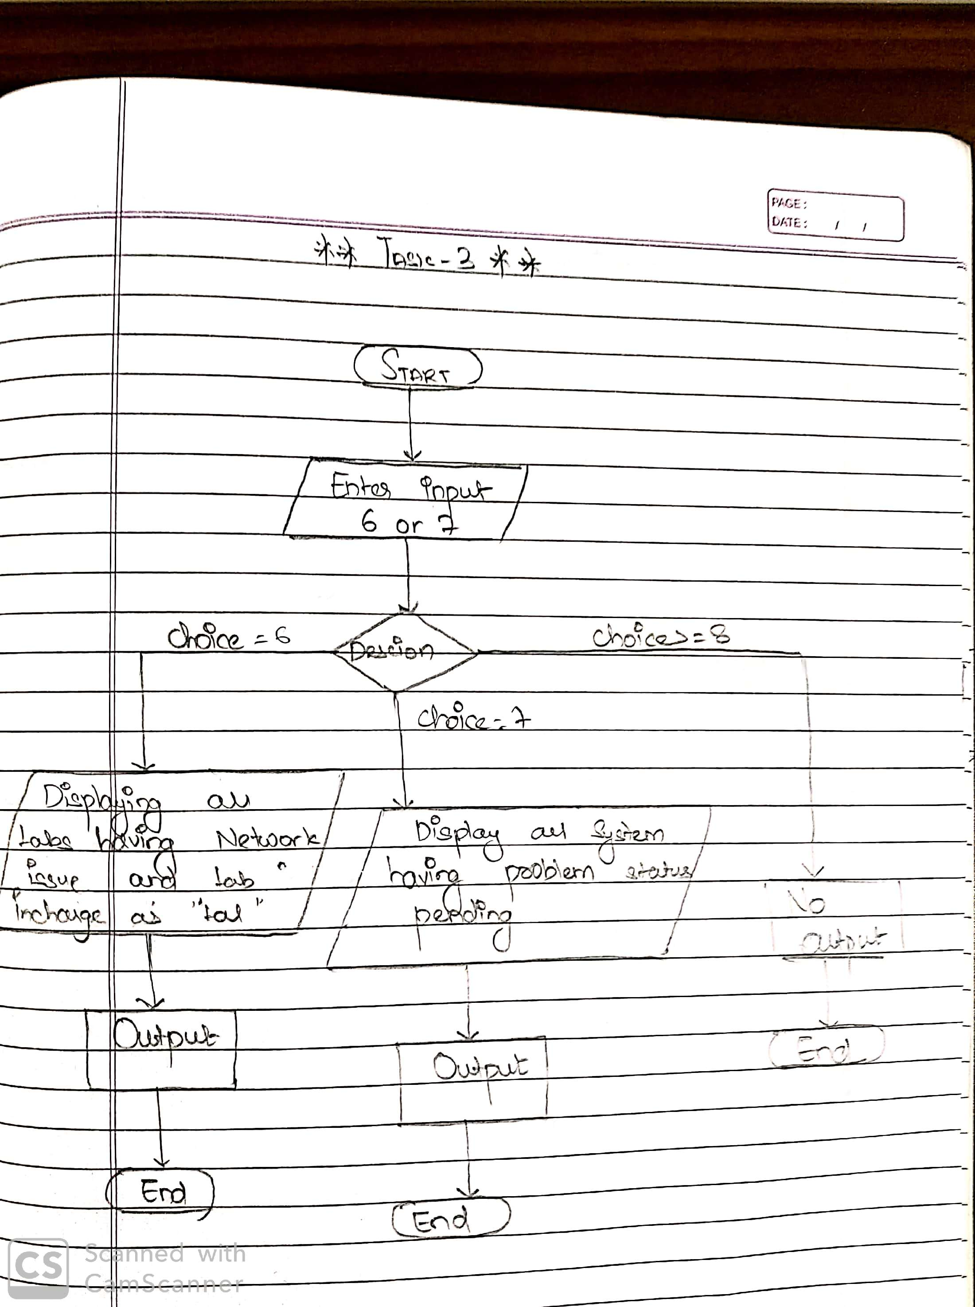
FLOWCHART:-

Slide 14
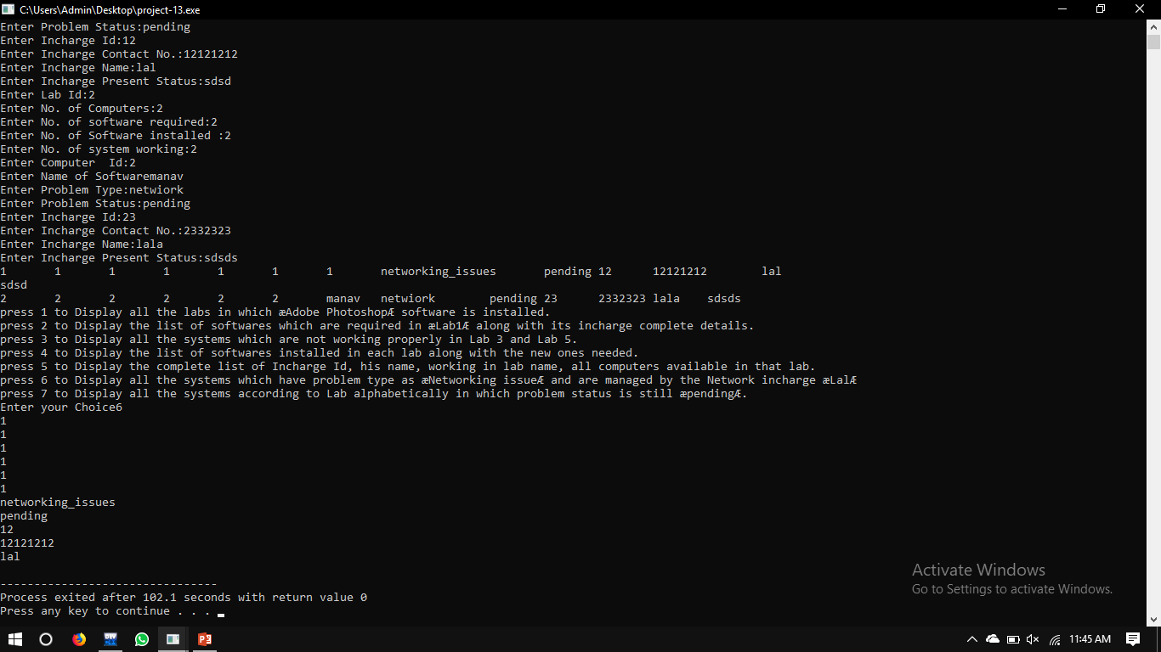
MEMBER-3 Task-6: Display all the systems which have problem type as ‘Networking issue’ and are managed by the Network incharge ‘Lal’
=>Screenshot

Slide 15
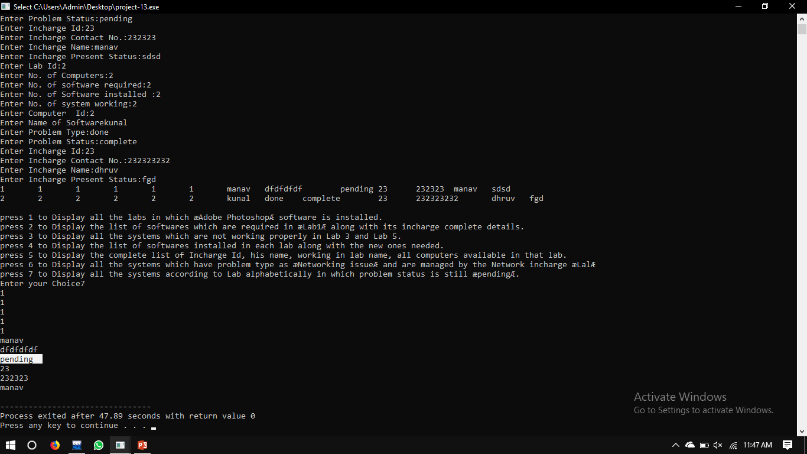
Task-7: Display all the systems according to Lab alphabetically in which problem status is still ‘pending’
=>Screenshot

